Slide 1
Introduction of New Faculty, Staff and Administration
Celia Barberena, Ph.D.
Chabot College Day

Slide 2
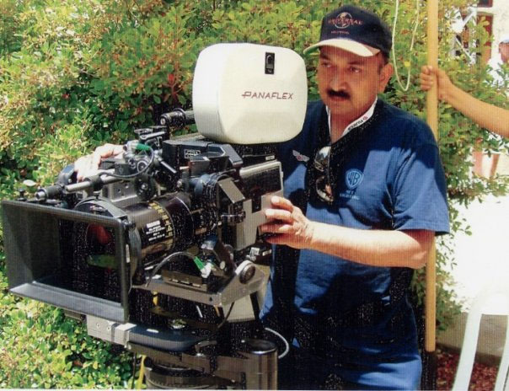
New Faculty, Staff and Administration
Sujoy Sarkar, Broadcasting Cablecasting Technician
  Dedication to Service

Slide 3
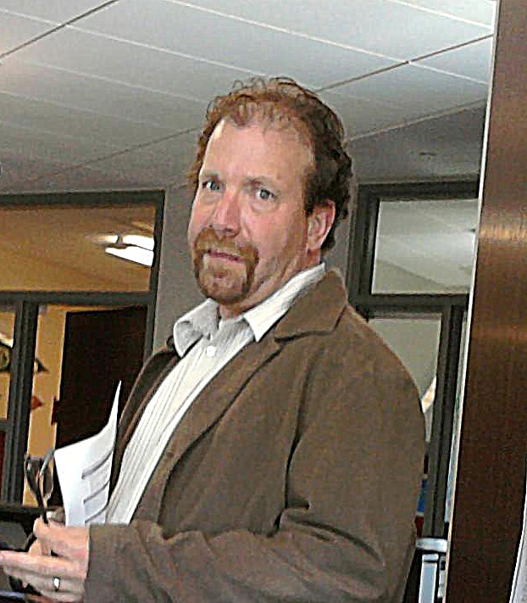
New Faculty, Staff and Administration
Dan Abrami, Employment Coordinator for Program Renew
  Giving opportunity to those affected by our bad economy

Slide 4
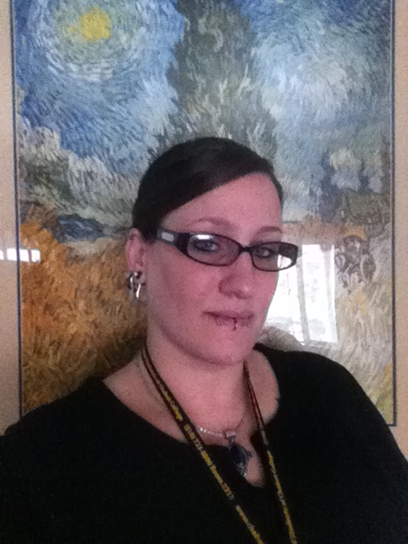
New Faculty, Staff and Administration
Chastity Whiteside, Administrative Assistant II, Science and Math Division
  Efficiency, service and smarts

Slide 5
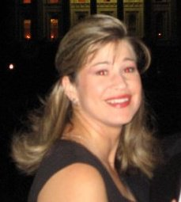
New Faculty, Staff and Administration
Jamie Shreve, Family Resource Coordinator
  Giving service to our children and their families

Slide 6
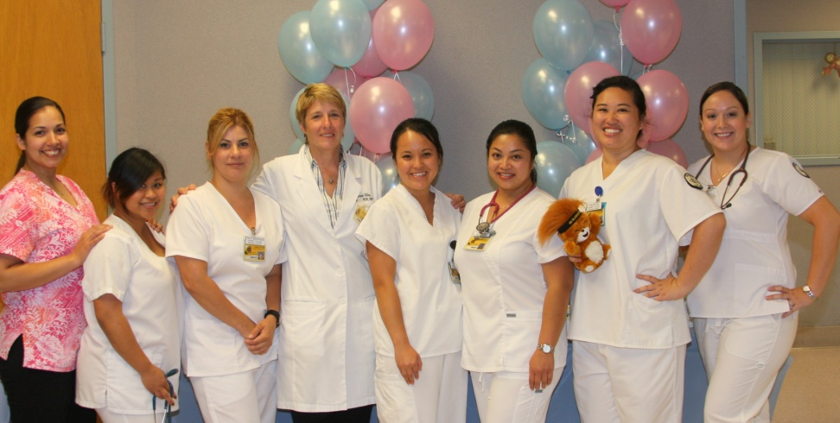
New Faculty, Staff and Administration
Connie Telles, Nursing Program Director
  Innovation and Creativity

Slide 7
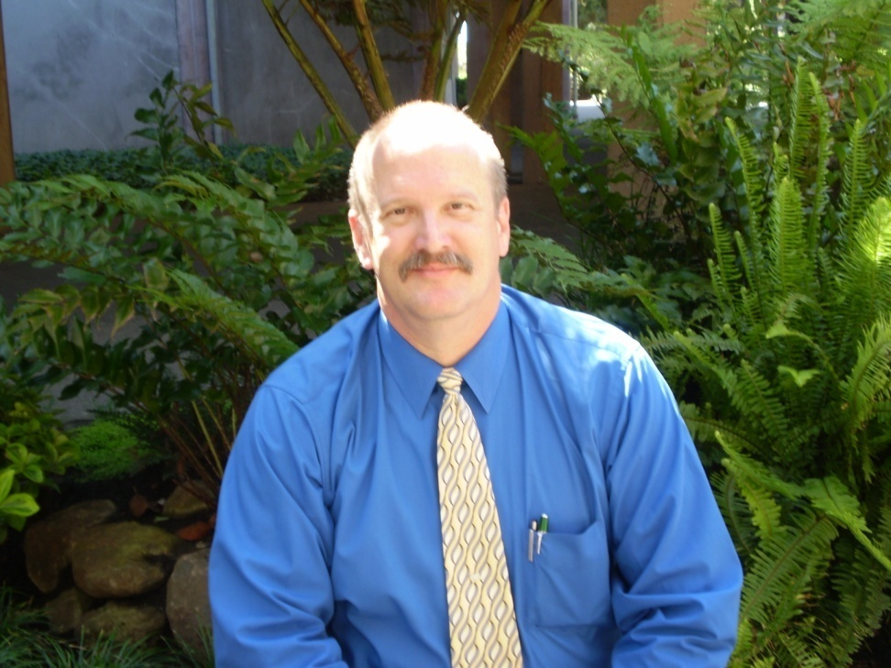
New Faculty, Staff and Administration
Keith Stiver, Director of Campus Safety
  Professionalism and attention to service

Slide 8
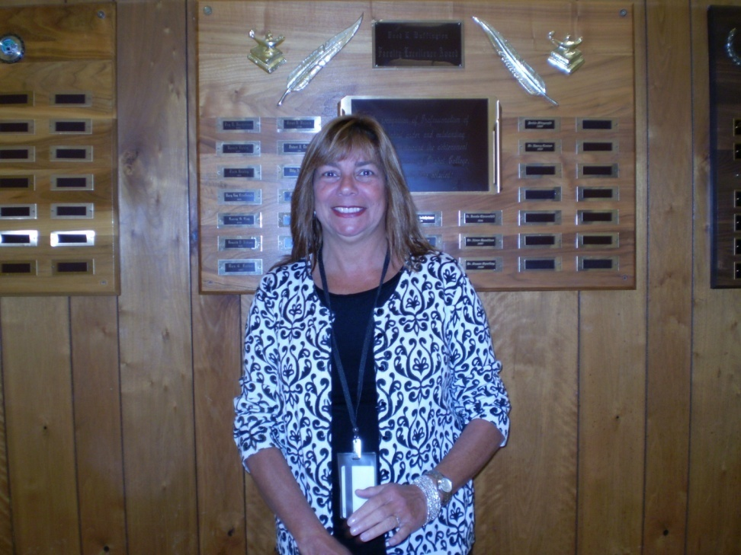
New Faculty, Staff and Administration
Elaine Balardi, Nursing/Psychiatric Nursing Instructor
  Strengthening a well oiled machine

Slide 9
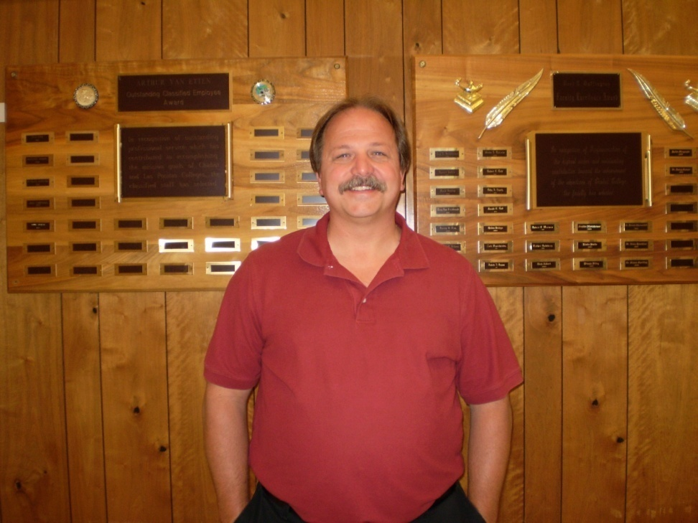
New Faculty, Staff and Administration
Kurt Shadbolt, Faculty, Automotive Technology
  Building partnerships with Industry

Slide 10
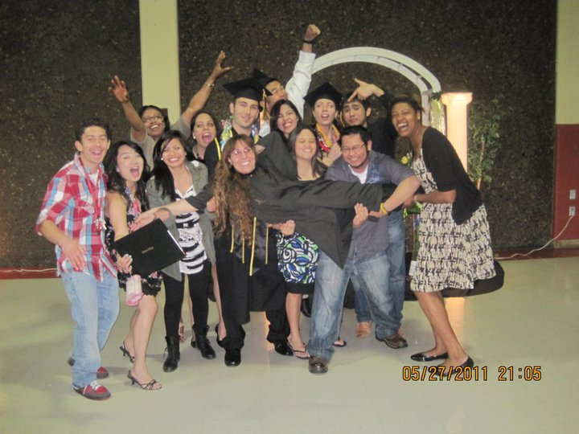
New Faculty, Staff and Administration
Danielle Preciado, Director of Student Life
  Going the extra mile

Slide 11
New Faculty, Staff and Administration
Sharon Daniels, Interim Bookstore Manager
  Called to Duty
Lynn Hansen, Laboratory Technician II
  Good service to faculty and students

Slide 12
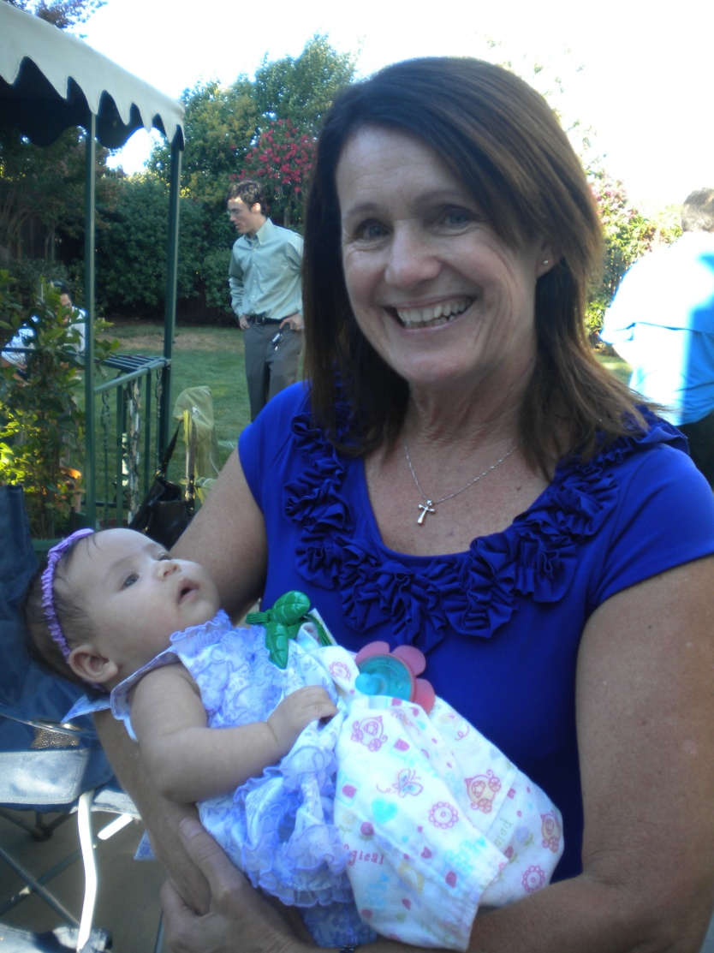
New Faculty, Staff and Administration
Rita Brown, Interim V.P. Administrative Services
  Very knowledgeable and service oriented

Slide 13
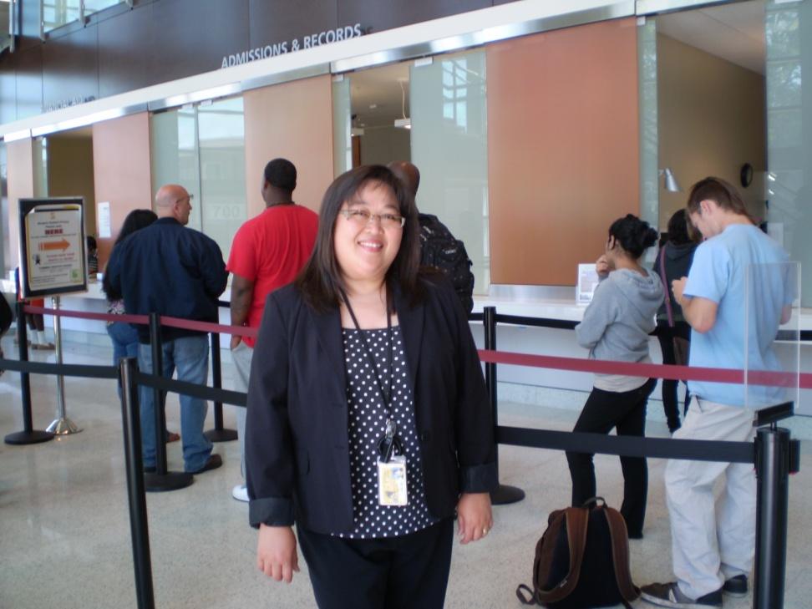
New Faculty, Staff and Administration
Paulette Lino, Director of Admissions and Records
  A shining new star

Slide 14
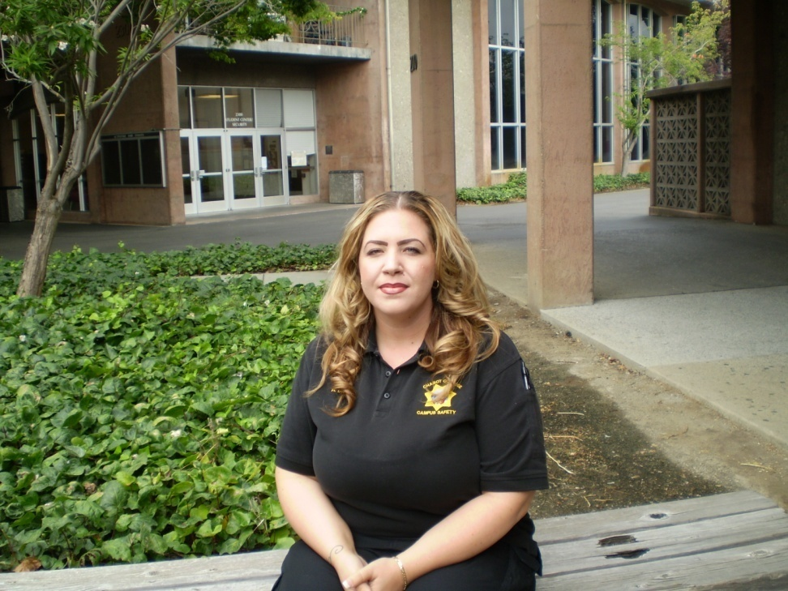
New Faculty, Staff and Administration
Rachelle Duran, Security Communications Dispatcher
  Attentive to our Safety

